Slide 1

Sentiment trading
Jeff Brinker, Justin Leffew, Ameira Khaleq

Slide 2

Overview
Observed & analyzed BTC,ETH,ADA to see the volatility over approximately the last 2 years to current day by applying algorithms and machine learning to assist in letting a crypto investor know to buy, sell, or hold on to their investments.
We applied $1000 as our base investment to see our profits and losses.

Slide 3
Questions
Is it better to buy and hold or develop a trading strategy?
Would there be patterns in volatility between the three crypto coins?
Will our algorithms show us which direction to go with our investments in order to increase profit and minimize losses?

Slide 4
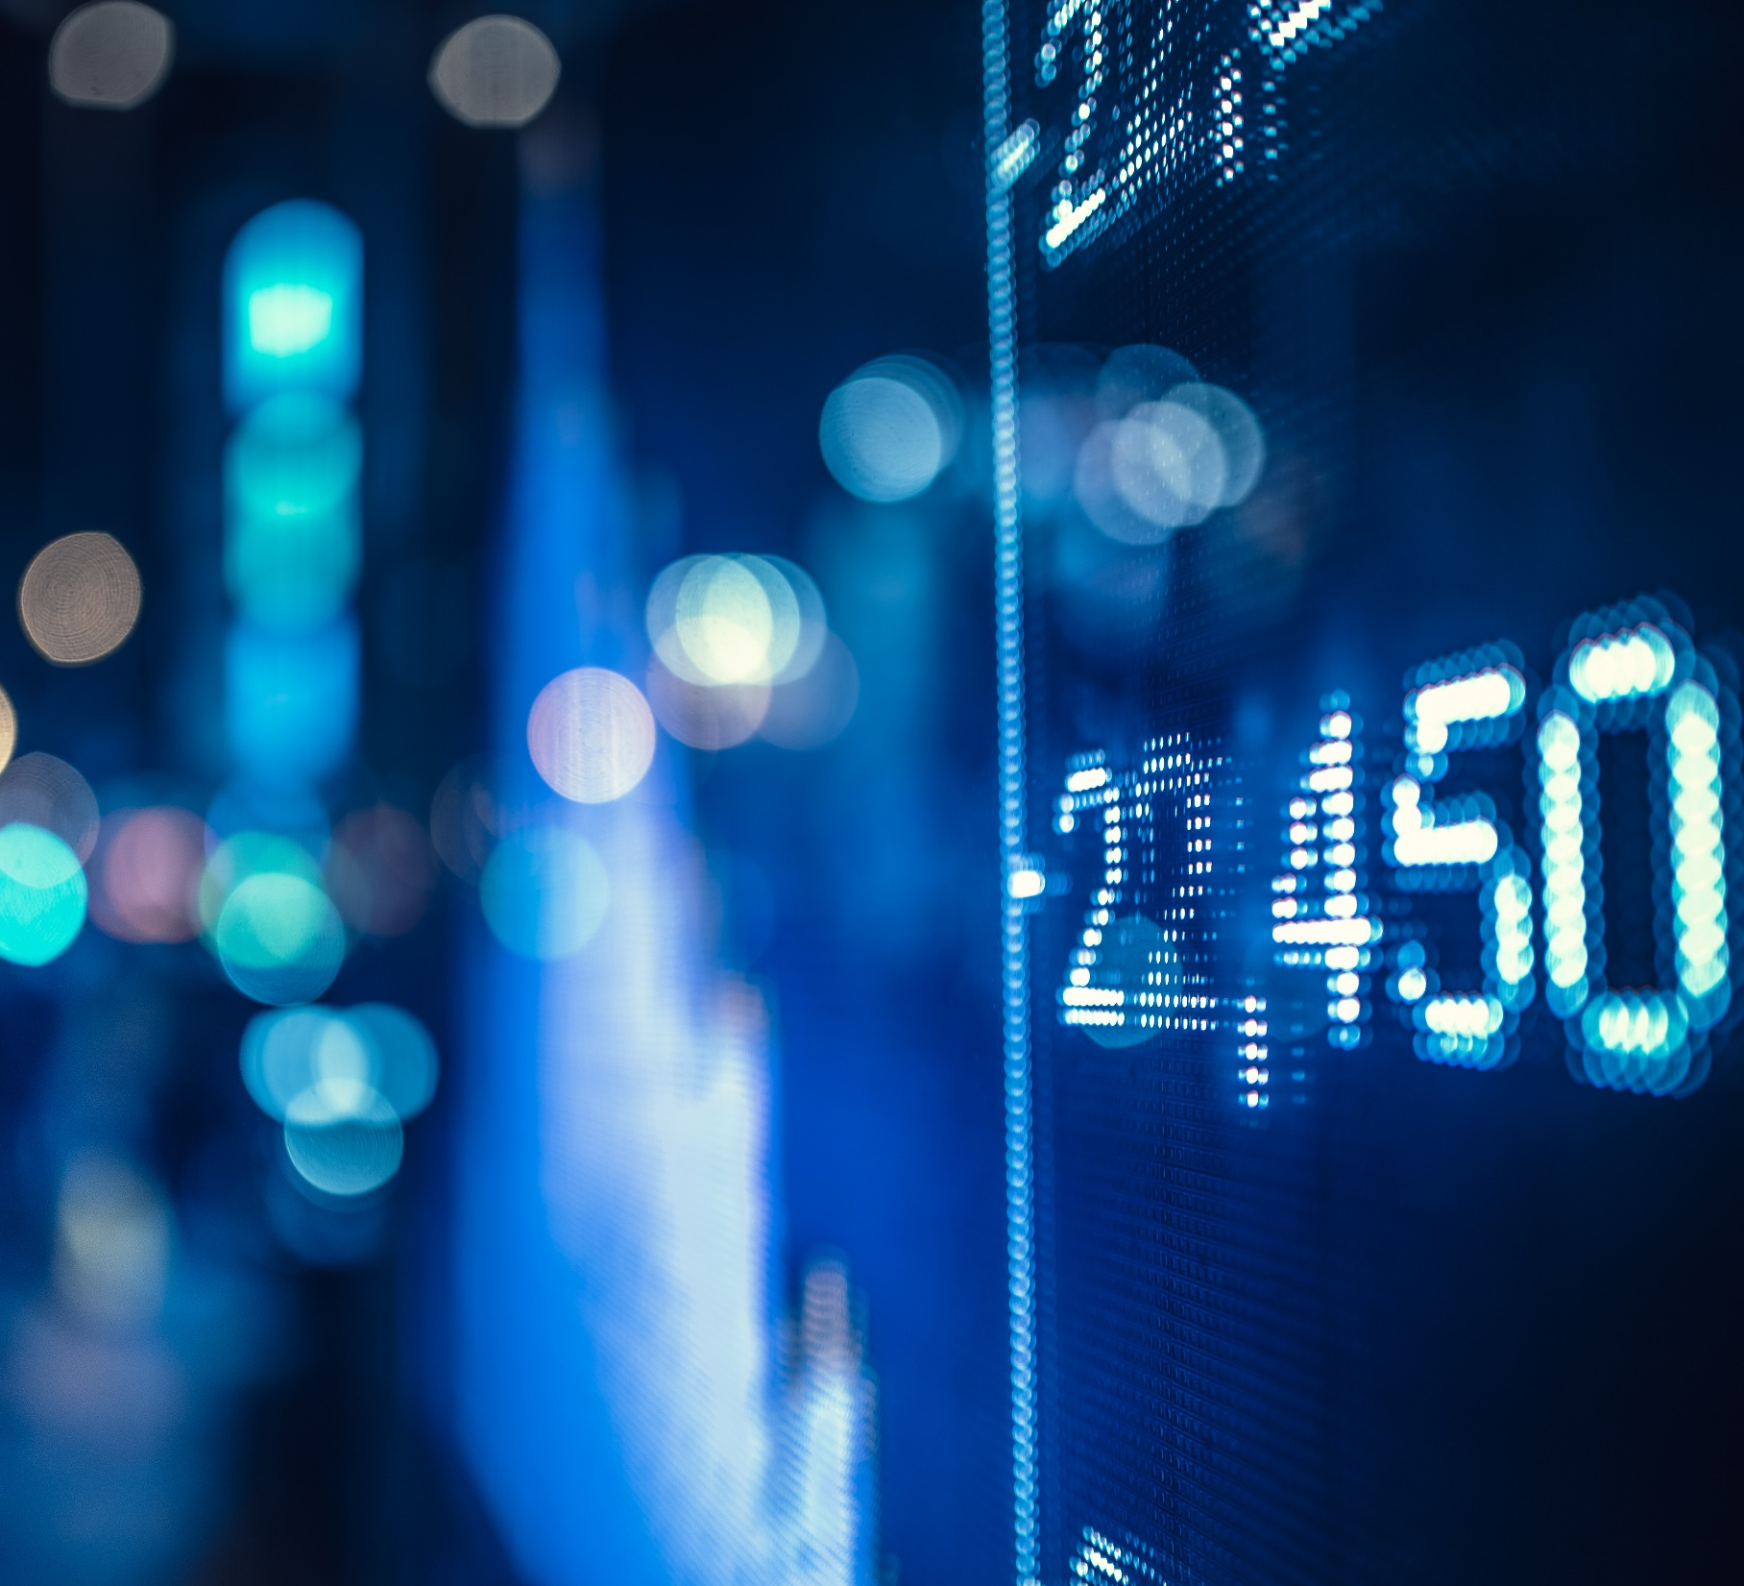
Indicators using our algorithms
When to Buy
When to Sell
When to Hold

Slide 5
Cryptocurrencies used
Bitcoin (BTC)
Ethereum (ETH)
Cardano (ADA)

Slide 6

Data PREP, Cleanup, & exploration
For data cleanup we used multiple loops to pull the data in the Fear and Greed index as well as in our algorithms. Data cleanup was modularized so that at the end we were able to run the entire data set against a different time frame without any issues.
APIs used were Fastquant for crypto data, Alternative.me for the Fear and Greed Index, Pytrend for Google Search Trends
Machine learning models used were Support Vector Machine Model (SVM) and SciKitLearn*

Slide 7
Issues & Trouble Shooting
Time constraint was the biggest issue
Data cleanup & preparation took longer than expected
We were unable to have SciKitLearn to function as was intended
The amount of crypto data we had was limited
Scope Creep

Slide 8
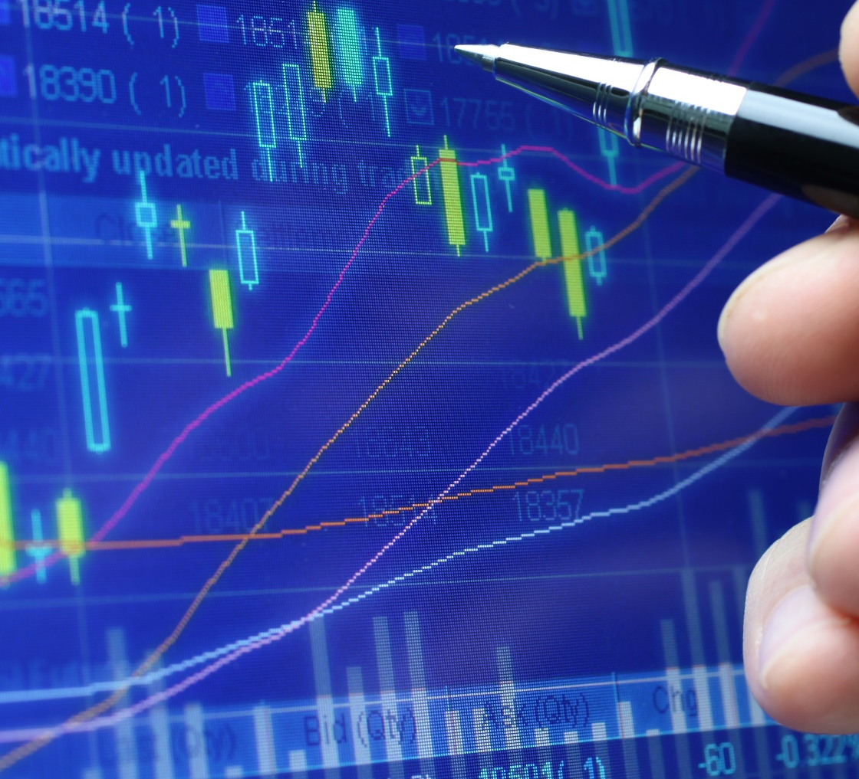
Observations & findings
A large reason the HODL outperformed our algorithms was most likely due to the timeframe that we used.
The crypto market is so new that there is high volatility with minimal factors that can change the volume so much.
The model demonstrated we can create a strategy with the data we used.

Slide 9
Machine learning model: SKLearn

